Slide 1
Oracle APEX on Multicloud
Build AI-powered, mission-critical enterprise apps faster
1
Copyright © 2025, Oracle and/or its affiliates | Confidential: Internal/Restricted/Highly Restricted

Slide 2
Safe harbor statement

Slide 3

What is Oracle APEX ?
Oracle APEX is trusted worldwide to deliver mission-critical, data-driven apps that are secure, scalable, and easy to build.
Oracle APEX is an enterprise AI application platform for building secure, scalable web and mobile applications.
Trusted by thousands of organizations, APEX powers systems that run core business operations every day.
With Oracle AI Database and Oracle Cloud Infrastructure, every application inherits built-in reliability, governance, and security.
APEX helps developers turn ideas into production-ready apps quickly, without sacrificing control or performance.

Slide 4



The Oracle APEX advantage
Use GenAI to rapidly build apps that meet business objectives
Focus on the intent of the app – not how to code it, and spend less time on maintenance going forward
Add AI to your apps
Add AI capabilities to apps even if you’re not an AI expert – giving users flexible options for using apps, and shortening their learning curve
Build enterprise-ready applications
Get the security, scalability, performance and reliability of Oracle Database
APEX is included with Oracle Database at no extra cost

Slide 5


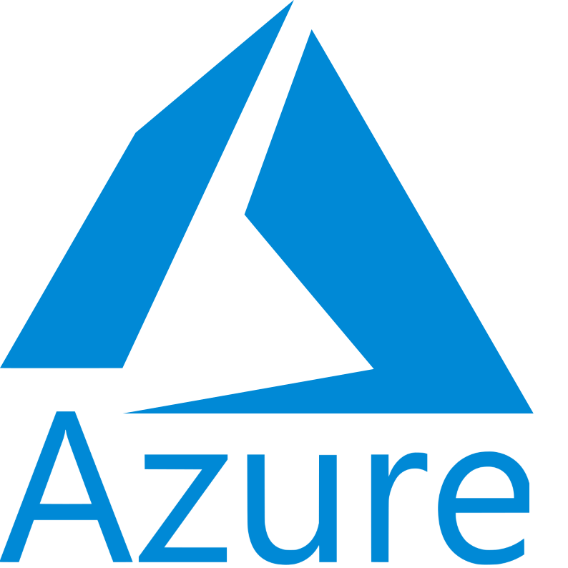






Oracle APEX is Available Everywhere
Oracle APEX is a fully supported no-cost feature of Oracle Autonomous and all Oracle Database editions
All Oracle Database editions
Oracle Exadata
Oracle Database Free
Oracle Database@Multicloud
Amazon RDS for Oracle Database
All other major clouds via VM
Autonomous Databases
All Autonomous DB workload types
Autonomous Database for Developers
High-Performance Database Options
Oracle Base Database Service
Oracle Exadata Service
Always free tier
Always Free APEX Service
Always Free Autonomous Database
OCI

Slide 6




Oracle APEX on ADBS: workload-optimized instances
Oracle Autonomous Database Serverless with APEX
Lakehouse
Full ADBS service optimized for analytics and AI workloads
Transaction Processing (ATP)
Full ADBS service optimized for transactional and mixed workloads
One-click, data-preserving operation:
JSON Database
Specialized JSON service, limited relational storage, low price
APEX Service
Specialized APEX service, no SQL*Net connectivity, low price
= Workload Type Conversion

Slide 7
Advantages of Oracle Database & APEX on Multicloud
Platform Reach
AWS: Exadata Dedicated, Autonomous DB
Azure: Exadata Dedicated, Exascale, Autonomous DB
Google Cloud: Exadata Dedicated, Exascale, Base DB Service, Autonomous DB
Core Advantages
Low-Latency: Database co-located with hyperscaler service
Easy Migration: Zero application/database rewrites
Unified Ops: Single invoice & counts toward cloud commit
Seamless Integration: Native IAM, networking, monitoring

Slide 8
Why APEX Delivers Unmatched Multicloud Value
Preserve your Investment
Develop locally on a free container, deploy to any cloud. Move seamlessly from on-premises to cloud, or between AWS, Azure, and Google Cloud, with minimal infrastructure provisioning.
Reduced Cost of Ownership
No application changes needed when switching cloud providers. Build once, deploy anywhere, eliminating expensive rewrites and accelerating time-to-value across your multicloud estate.
Cloud Flexibility & Innovation
Leverage cutting-edge AI tools from Google Cloud, advanced analytics from Azure, or ML services from AWS, all whilst keeping your Oracle APEX applications portable and your data sovereign.
Enterprise Resilience
Build true Multicloud failover solutions to protect against regional outages. Deploy redundant instances across providers for mission-critical applications requiring maximum uptime.
Oracle APEX on Multicloud means meeting customers where they are, no matter which cloud you have adopted, enterprise-grade AI App development platform is ready to accelerate your digital transformation.

Slide 9

We started addressing these scenarios five years ago…
Oracle Database@Azure
East US
East US 2
West US
Brazil South
France Central
Germany West Central
Italy North
UK South
UK West
Australia East
Australia Southeast
Japan East
Southeast Asia
Oracle Database@AWS
US East 1
US West 2
17 More regions planned
2019 – 2022
2023
2024
2025
Azure Interconnect
Ashburn
London
Toronto
Tokyo
Amsterdam
San José
HeatWave on AWS
N. Virginia
Tokyo
Mumbai
London
Frankfurt
Google Cloud Interconnect
Ashburn
Montreal
Frankfurt
Madrid
London
Sydney
Oracle Database @Google Cloud
Frankfurt
London
Ashburn
Salt Lake City
Tokyo
10 More regions planned
São Paulo
Frankfurt
Phoenix
Seoul
Singapore
Johannesburg
Melbourne
Mumbai
Tokyo
Singapore
Sao Paulo

Slide 10







Now you can run your trusted database, as a service, anywhere
Run in any hyperscale public cloud
Run cloud on-premises
OCI Dedicated Region
Exadata Cloud@Customer
Same Database. Same Features. Same Pricing.

Slide 11





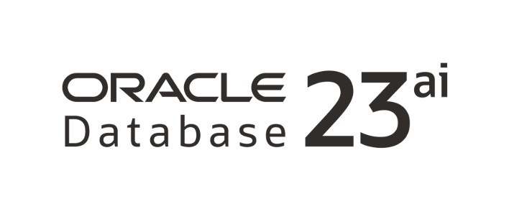
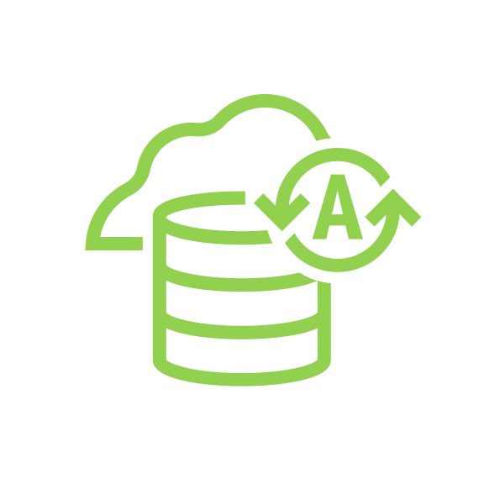


Build new Apps with Oracle Database in hyperscaler dev stack
Before
After
May not meet performance, availability, security needs
Overhead of many single-purpose DBs
Overhead of additional services for AI and analytics
Enterprise-grade performance, availability, security
Supports all data types (tables, JSON, vectors)
Built-in GenAI and machine learning, no data movement
App
Other database services
Containers
Oracle Database services next to your cloud apps
“With the unparalleled quality of D&B data, we can now seamlessly integrate Oracle Database’s performance, reliability, and scalability with Google Cloud’s powerful analytics and AI tools.”

Slide 12
OCI Oracle Database Service availability
OCI Services | Microsoft Azure | Google Cloud | Amazon Web Services (Planned) | OCI
Regions | East US, East US 2, US West, Central US, Canada Central, UK South, UK West, Germany West Central, France Central, Italy North, Australia East, Australia Southeast, Japan East, Southeast Asia, Brazil South, and planned regions | US-east4, US-west3, Europe-west2, Europe-west3, Asia-northeast1, and planned regions | US-east-1 US-west-2 | 50 public cloud regions, Dedicated Regions, Cloud@Customer
Oracle Autonomous Database Serverless | ✓ | ✓ |  | ✓
Autonomous Transaction Processing, Autonomous Data Warehouse | ✓ | ✓ |  | ✓
Autonomous JSON, Application Express (APEX) | ✓ | ✓ |  | ✓
Oracle Autonomous Database Serverless Pay-as-you-go | ✓ | ✓ |  | ✓
Oracle Autonomous Database Dedicated |  |  | ✓ | ✓
Oracle Exadata Database Service | ✓ | ✓ | Limited Preview | ✓
Oracle Zero Data Loss Autonomous Recovery Service | ✓ | ✓ | Planned | ✓
Oracle Data Safe | ✓ | Planned | Planned | ✓
Oracle Autonomous Data Guard | ✓ | Planned | Planned | ✓
Oracle GoldenGate | ✓ | Planned |  | ✓
Oracle Base Database Service | ✓ | ✓ |  | ✓
Oracle Interconnect | ✓ | ✓ |  | N/A

Slide 13
Oracle APEX@Azure

Slide 14





Oracle Database@Azure
Region Availability
Native Services Offered
31
IAM – Azure AD with SAML
(Regions as of December 2025)
AI/ML - OpenAI Service, Cognitive Services, Machine Learning
Five additional regions planned within the next 12 months:
Storage Service - Azure Blob Storage for direct file operations
Brazil Southeast
France South
North Central US
South India
West Europe
Other Services – Azure Monitoring

Slide 15
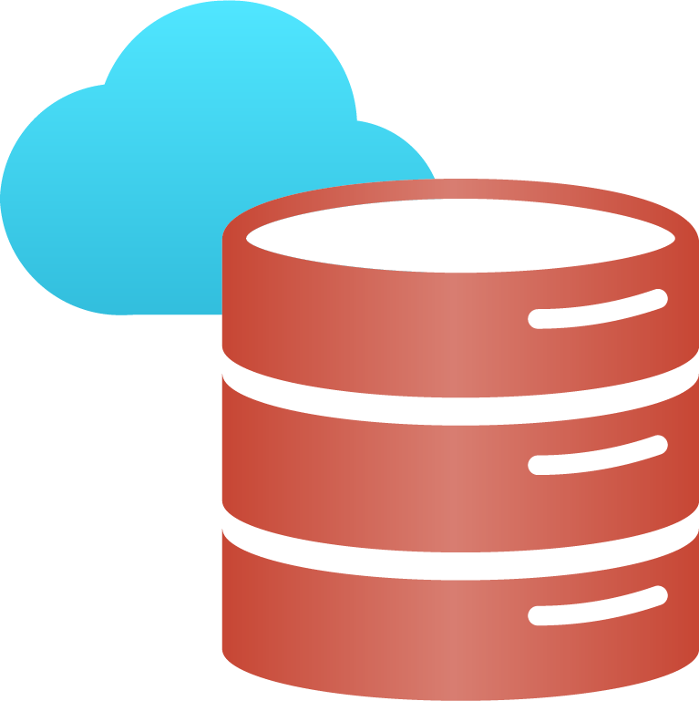




Oracle APEX Availability at Azure
Oracle Database@Azure offers the following Oracle Database services for APEX
Oracle Base Database Service
Oracle Autonomous Database – APEX comes Pre Installed
Oracle Exadata Database Service on Dedicated Infrastructure
Oracle Exadata Database Service on Exascale Infrastructure
APEX
Base Database
Autonomous
Database
Exadata

Slide 16
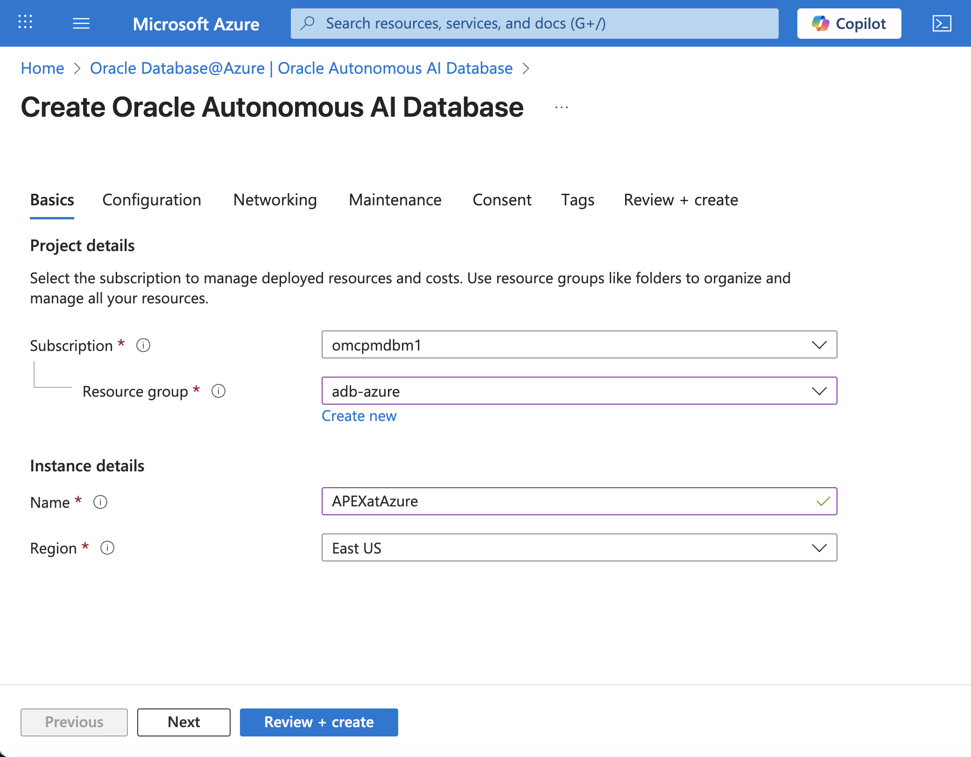
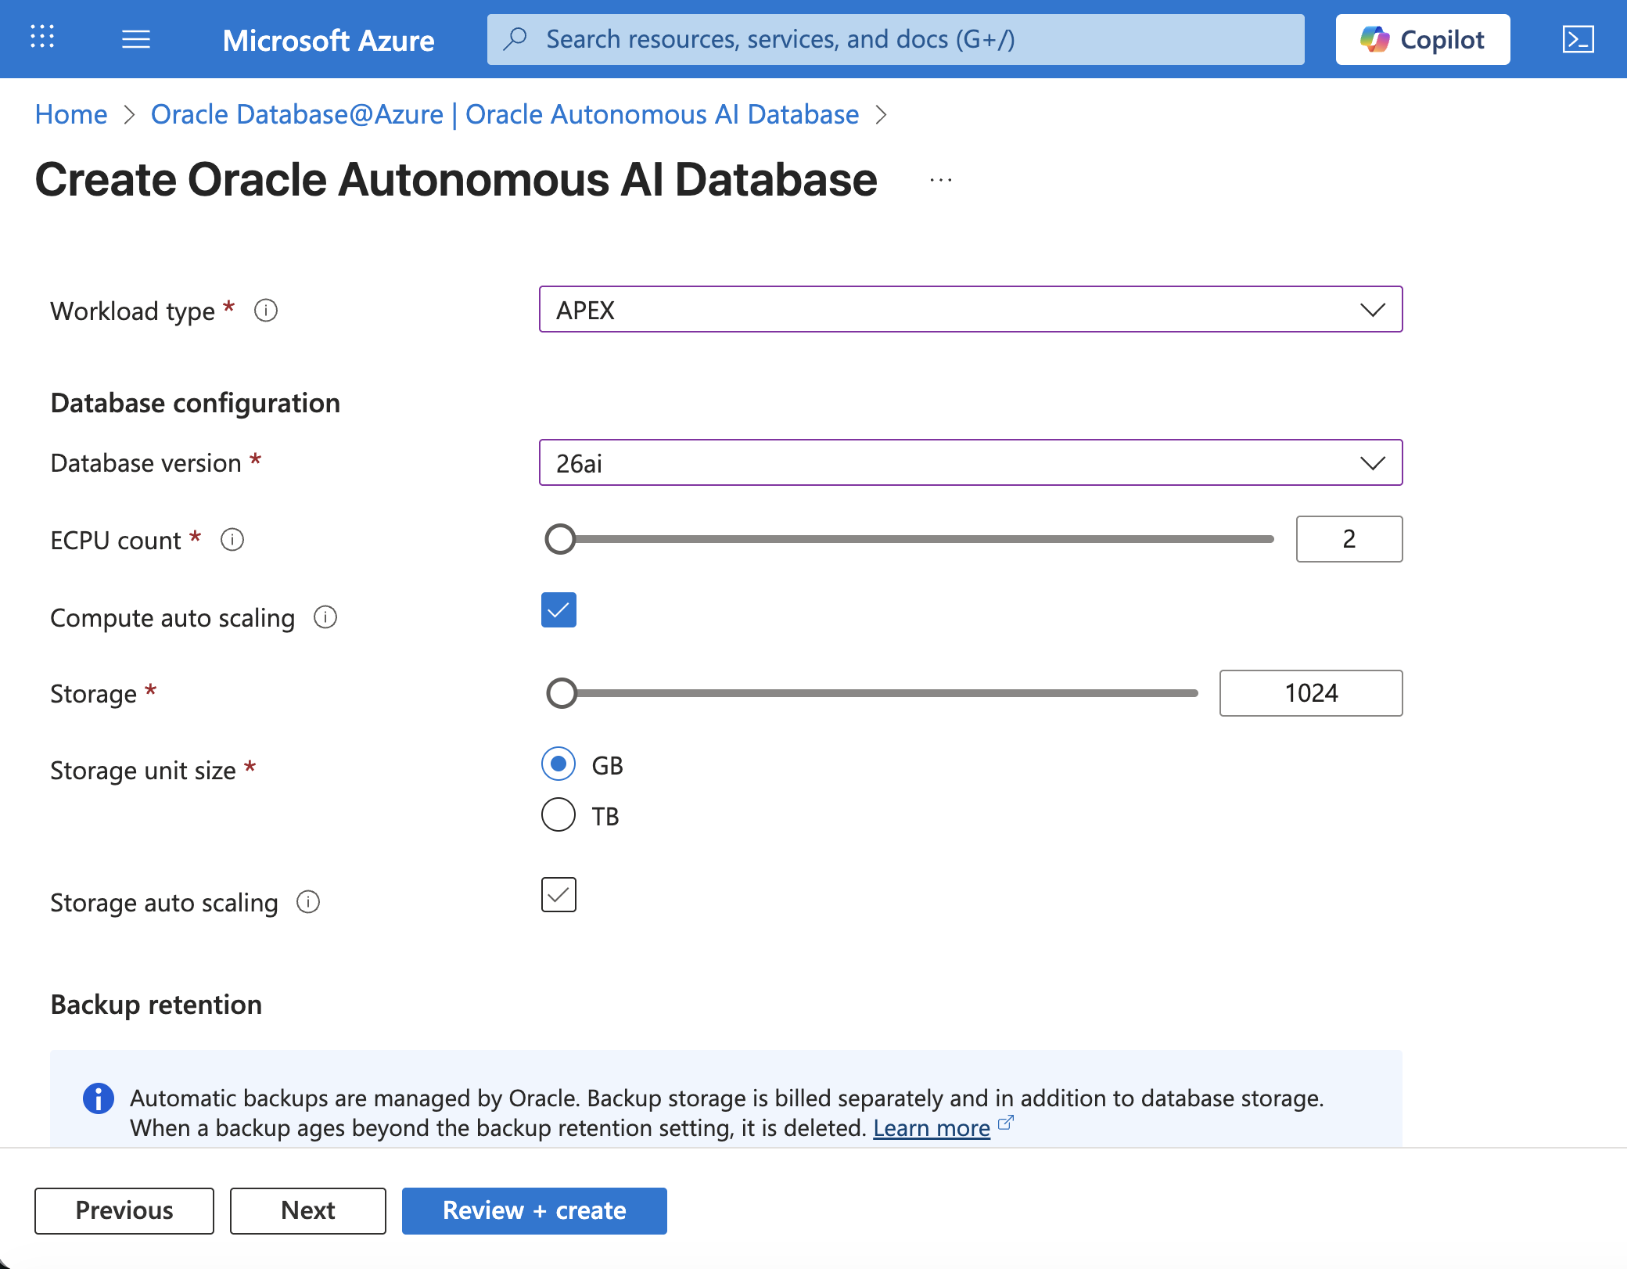
How to Provision autonomous Database and APEX on Azure?

Slide 17
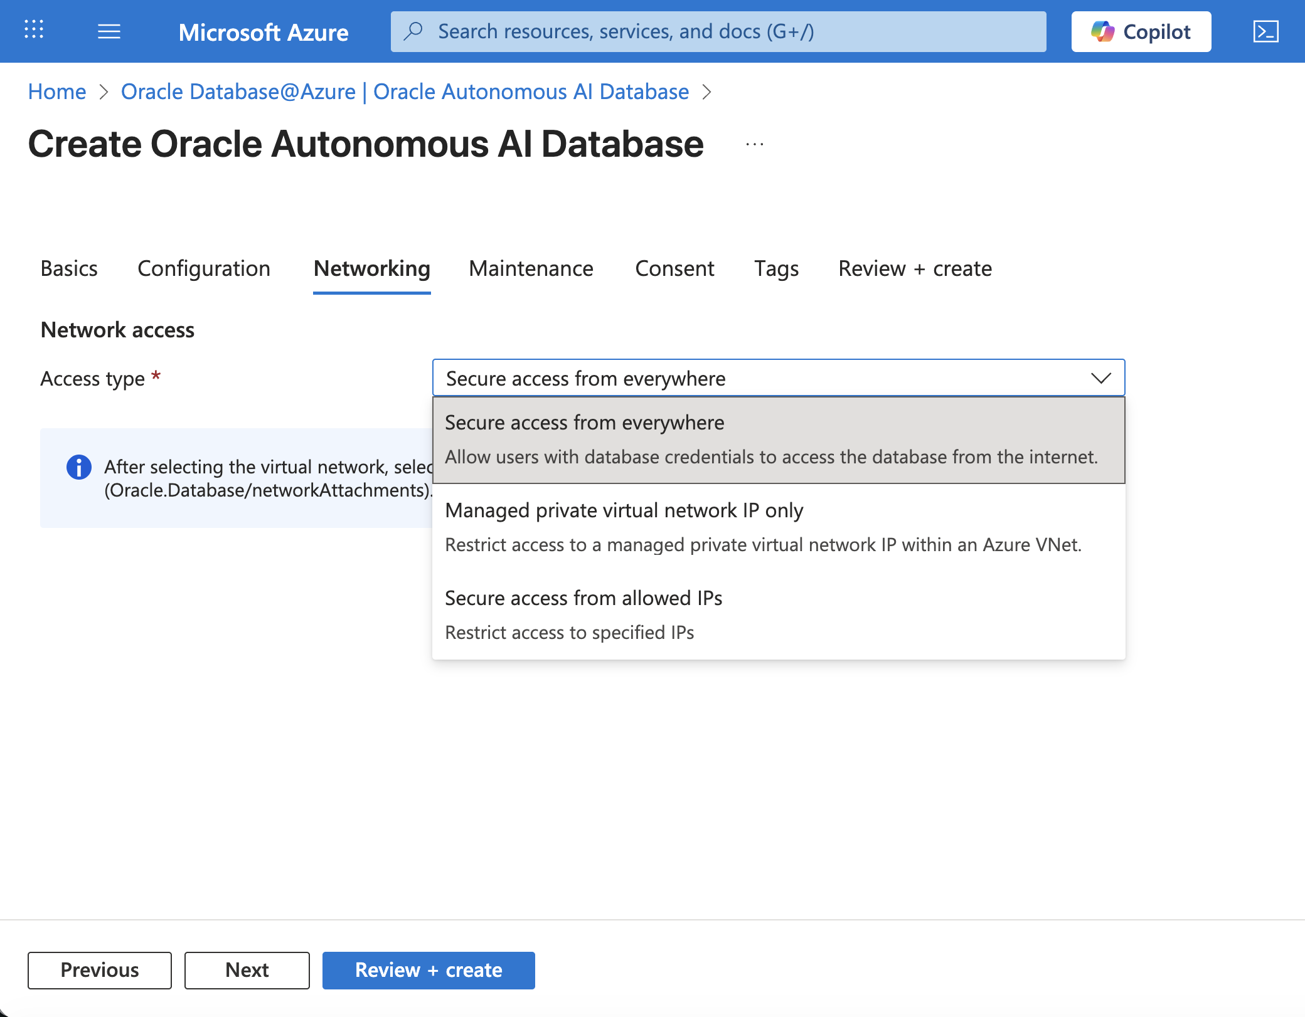
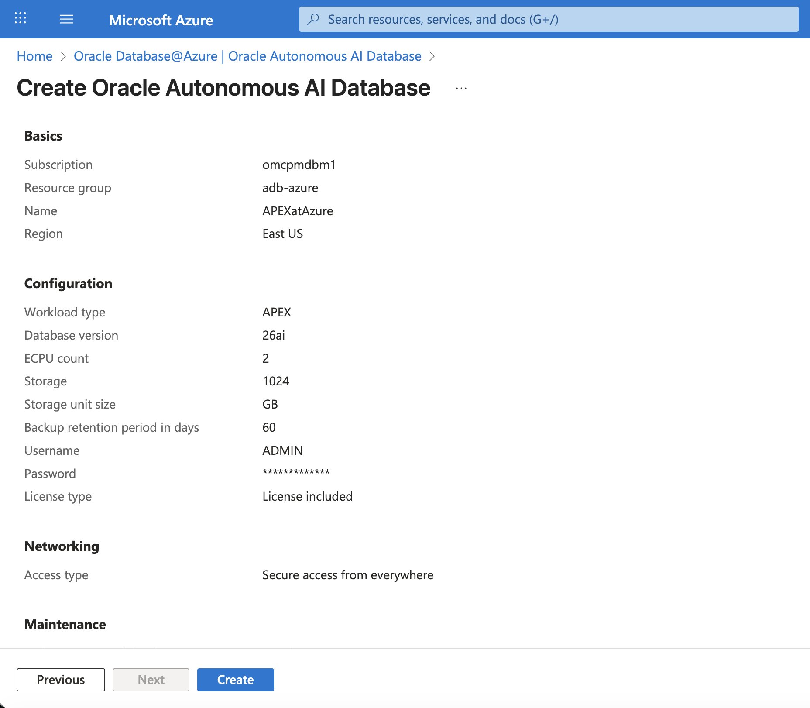
How to Provision autonomous Database and APEX on Azure?

Slide 18
Oracle APEX@AWS

Slide 19
Oracle Database@AWS
Region Availability
Native Services Offered
5
US East N. Virginia
US West Oregon
US East (Ohio)
Frankfurt
IAM – AWS IAM
Regions as of December 2025
AI/ML - Bedrock, SageMaker, Rekognition
20 additional AWS regions planned, including
Storage Service - AWS S3 via REST APIs or SDK
US West (N. California)
Asia Pacific
Europe
South America
Other Services – AWS CloudWatch for Monitoring, Event Bridge for Automation

Slide 20

Oracle APEX Availability at AWS
Oracle Database@AWS offers the following Oracle Database services for APEX
Oracle Autonomous Database – APEX comes Pre-Installed
Oracle Exadata Database Service on Exascale Infrastructure
APEX
Exadata
Autonomous
Database

Slide 21
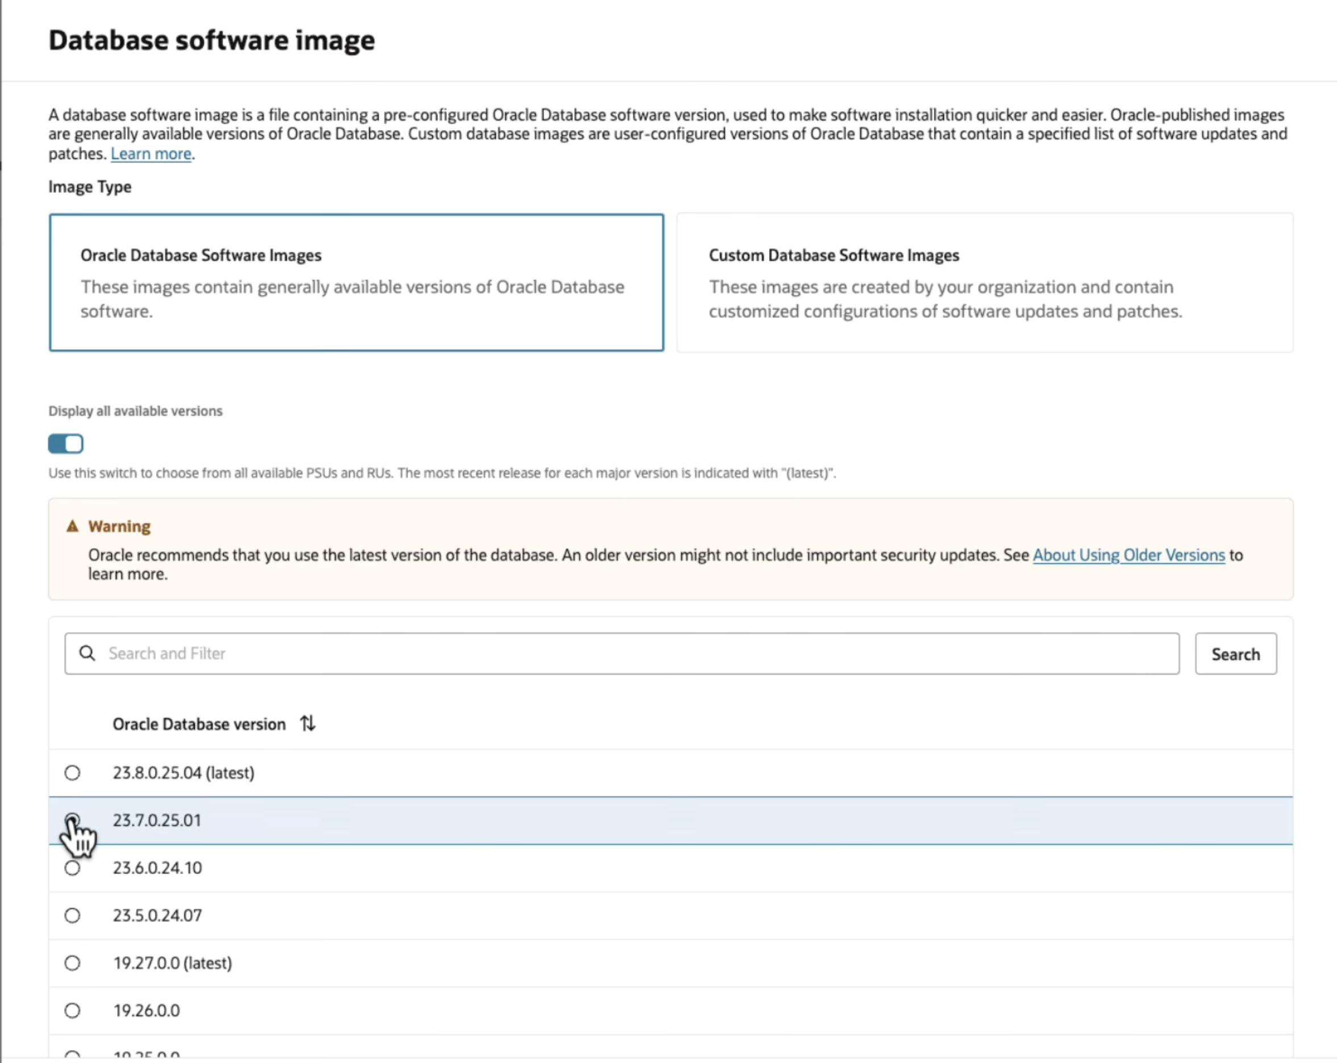
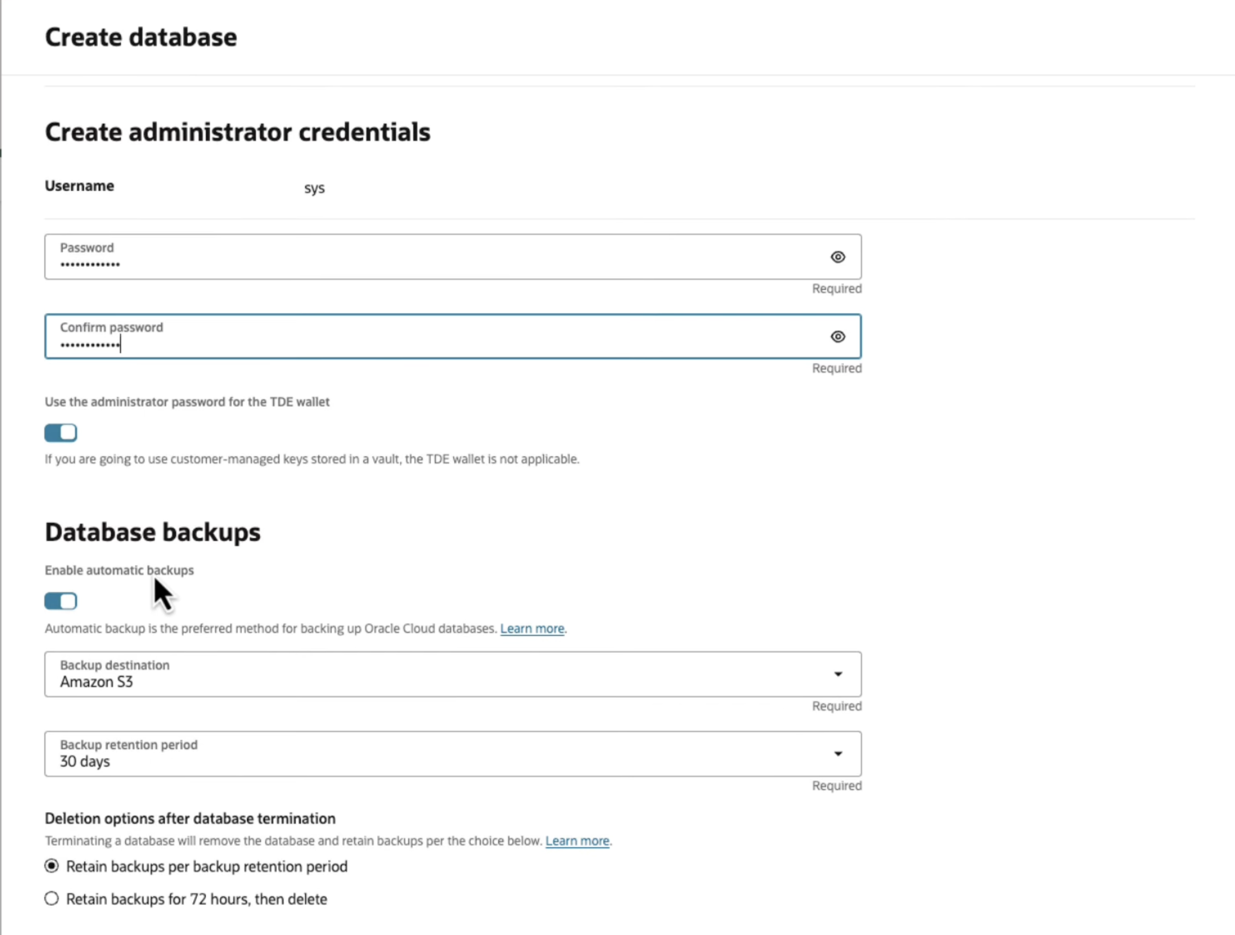
How to Provision APEX Application Development Service in AWS?

Slide 22
Oracle APEX@GCP

Slide 23
Oracle Database@GCP
Region Availability
Native Services Offered
Australia-Southeast 2 (Melbourne)
NA-Northeast 1 (Montreal)
US Central 1 (Iowa)
Asia-Northeast 1 (Tokyo)
Germany Central (Frankfurt)
UK South (London)
US East (Ashburn)
US West (Salt Lake City)
IAM – Google Identity(SAML)
11
Regions as of December 2025
AI/ML - Vertex AI, Vision AI, Natural Language API
Storage Service - Google Cloud Storage using API-based access
9 additional GCP regions planned within next 12 months
Other Services – Google Cloud Observability for monitoring, Google Cloud API, CLI, and SDK for resource management

Slide 24


Oracle APEX Availability at GCP
Oracle Database@GCP offers the following Oracle Database services for APEX:
Oracle Base Database Service
Oracle Autonomous Database – APEX comes Pre Installed
Oracle Exadata Database Service on Dedicated Infrastructure
Oracle Exadata Database Service on Exascale Infrastructure
APEX
Base Database
Exadata
Autonomous
Database

Slide 25
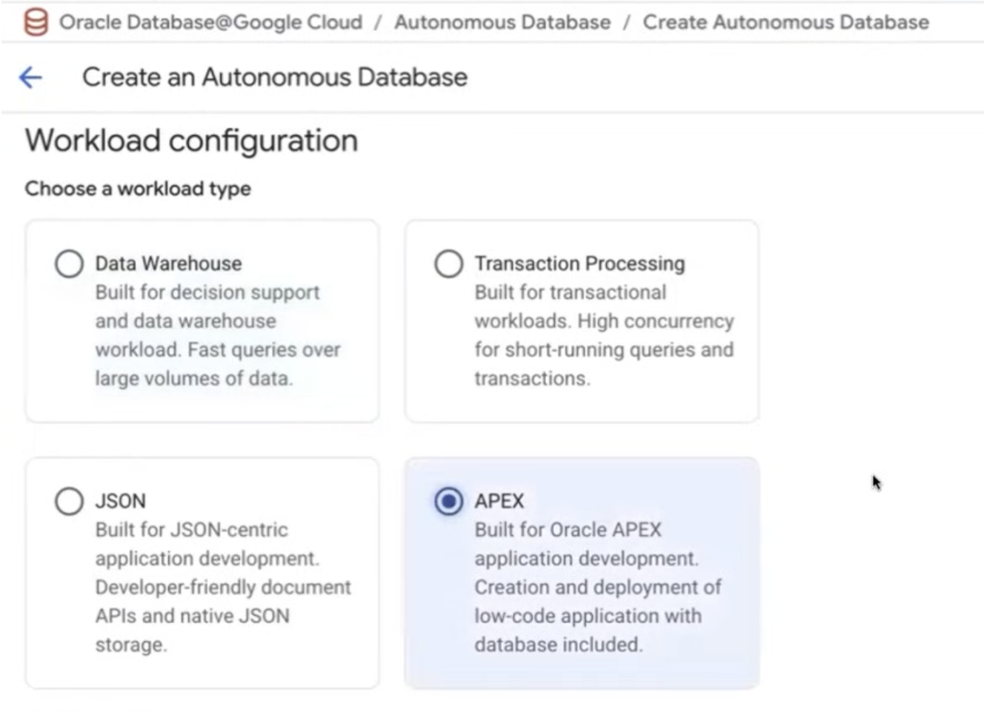
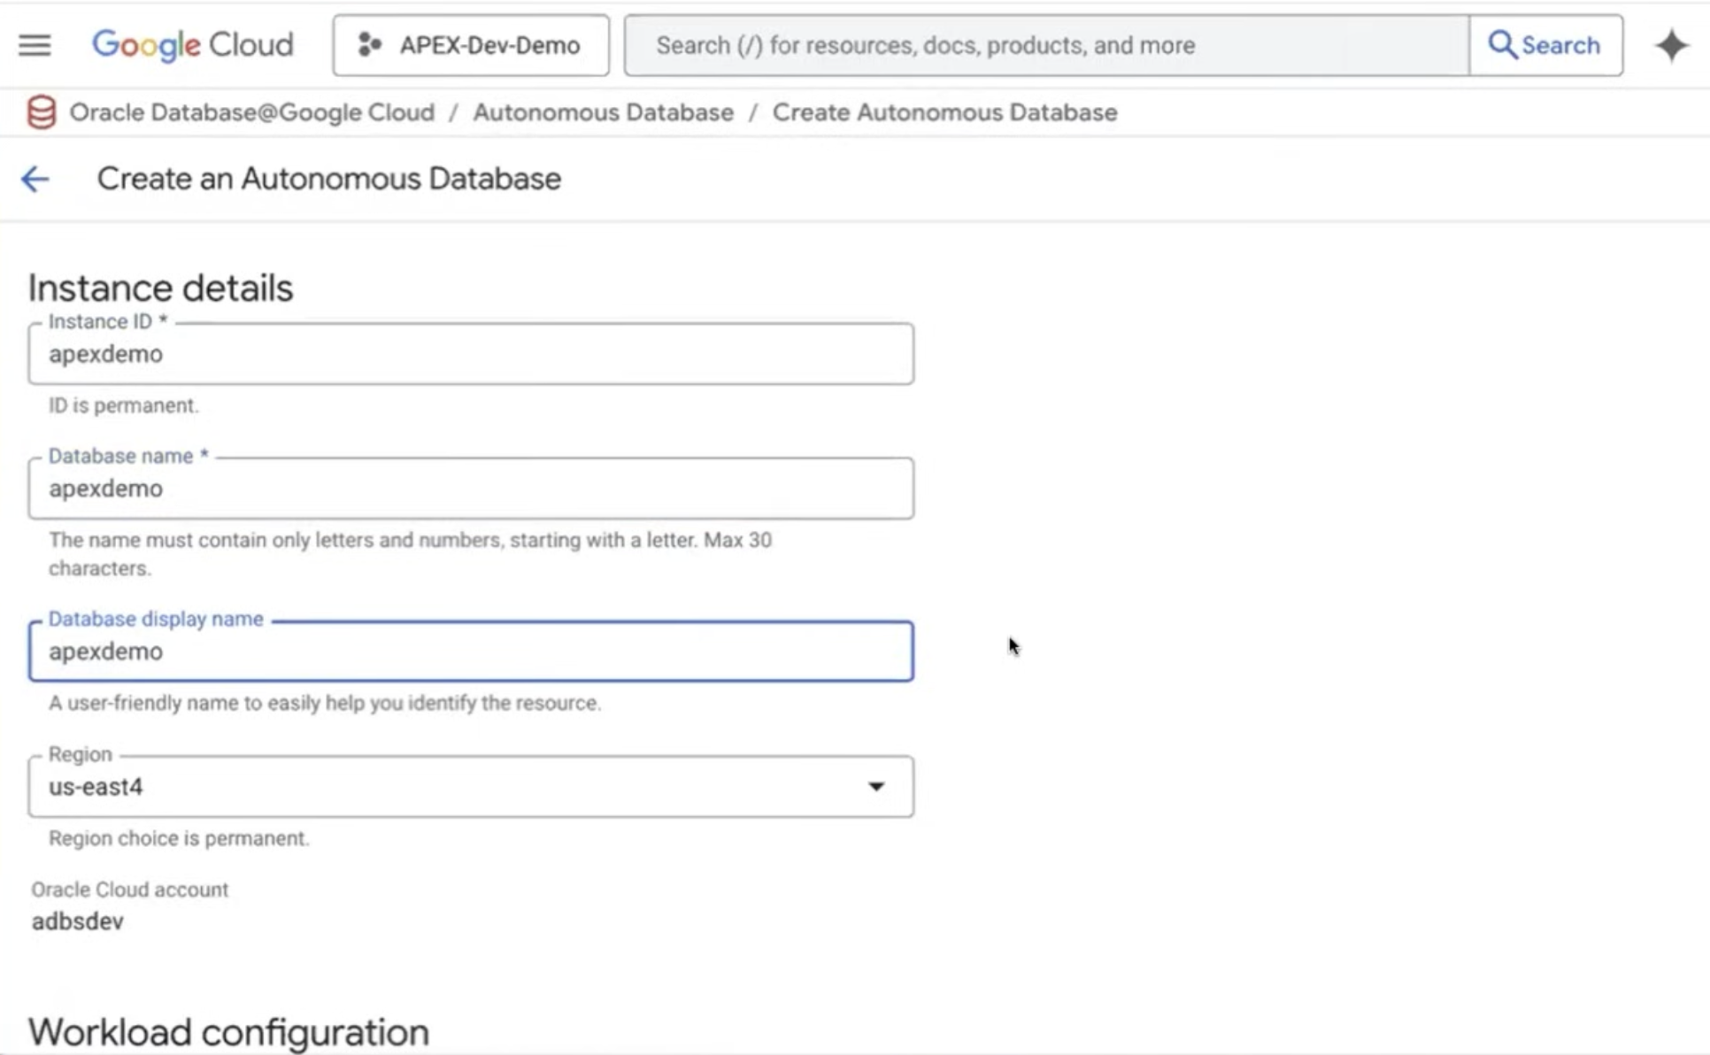
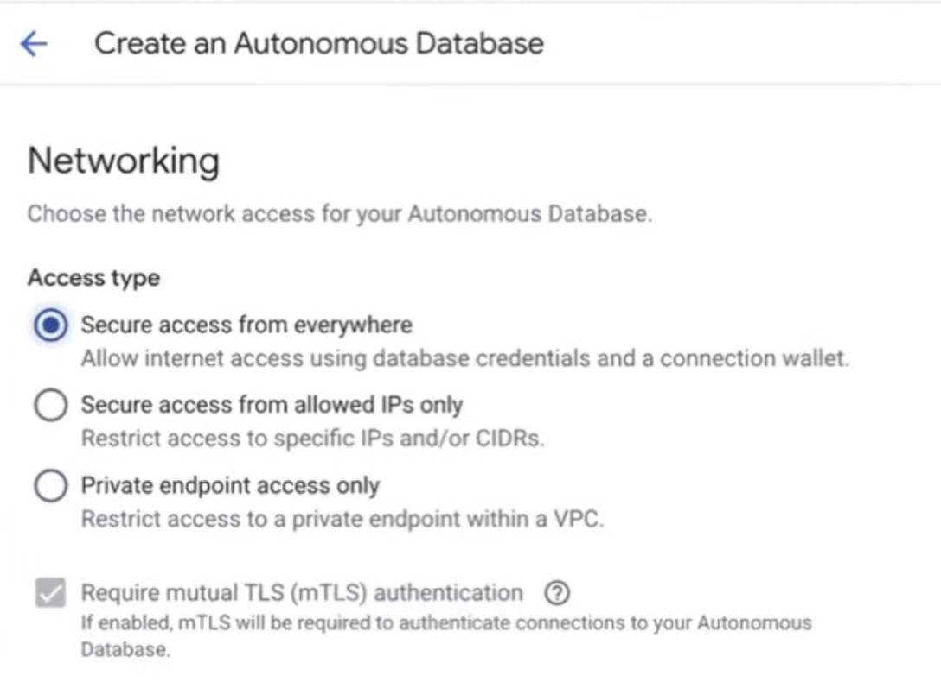
How to provision autonomous Database and APEX on GCP?

Slide 26

Oracle is constantly updating Autonomous AI Database, including APEX and ORDS. If you use Azure, AWS or Google Cloud, you can now benefit, too.

Slide 27
Oracle APEX Training & Certification

Slide 28

Your Path to Master Oracle APEX
apex.oracle.com/go/training
Start Your Journey
Whether you are new to APEX or looking to advance your skills, we have the resources you need to succeed.
APEX Foundations
Build a solid base with our foundational course designed for beginners.
https://apex.oracle.com/go/foundations
APEX Developer Professional Learning Path
Take your expertise to the next level with our comprehensive professional certification program combining core development and AI capabilities.
https://apex.oracle.com/go/professional
http://apex.oracle.com/go/ai-learn
Get Certified
Earn your official Oracle certification and stand out in the marketplace.
https://apex.oracle.com/go/professional-ai-lp

Slide 29



Oracle APEX Professional Learning Path
Learning path consists of two key courses
Oracle APEX Developer Professional
Master the fundamentals of building powerful low-code applications. Learn to create secure, scalable web and mobile apps with industry best practices.
https://apex.oracle.com/go/professional
Oracle APEX: Empowering Low Code Apps with AI
Unlock the future of development by integrating AI and GenAI capabilities into your APEX applications for smarter, more intuitive solutions.
http://apex.oracle.com/go/ai-learn
#ORACLE
#LOWCODE
#ORCLAPEX
#ORCLAPEXCERTIFIED
#ORACLECERTIFIED
#AI
#GENAI

Slide 30
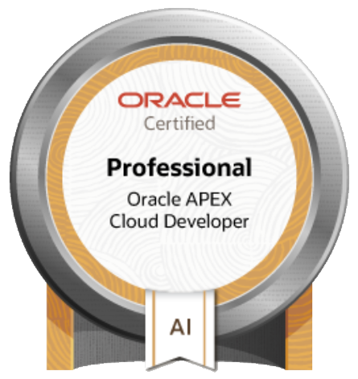
Get Oracle APEX Certified!
apex.oracle.com/go/professional-ai-lp
Validate Your Expertise
Stand out in competitive job markets by proving your Oracle APEX low-code development skills with official certification.
Master Best Practices
Demonstrate your understanding of building secure, scalable web and mobile applications with world-class features deployable anywhere—cloud or on-premises.
Showcase Low-Code Development Skills
Highlight your proficiency in modern low-code application development techniques and methodologies.
Gain AI-Powered Development Expertise
Enhance your capabilities in AI-powered and GenAI-enabled low-code application development.
Unlock Career Opportunities
Open doors to new roles and advancement with the prestigious Oracle APEX Cloud Developer Professional certification.
#Oracle #LowCode #orclAPEX #orclAPEXCertified #OracleCertified #AI #GenAI

Slide 31
Become a Certified Oracle APEX Developer Professional
apex.oracle.com/go/professional-ai-lp
1
2
3
4
5
Register
Login and Subscribe to the Learning Path for Free
Complete the first Course
Complete the Oracle APEX Professional Course along with Hands-on Labs
Complete the Second Course
Complete the Oracle APEX: Empowering Enterprise Apps with AI Couse along with the Hands-on Labs
Prepare for the Certification
Take up the Practice Exam and self asses your Skills
Get Certified
Pass the exam and earn your Badge!

Slide 32

THANK YOU

Slide 33
An end slide on light showing an Oracle logo

